Slide 1

ECE 2700
Digital Circuits
Binary Number and Calculations
Copyright © 2010 Frank Vahid
Instructors of courses requiring Vahid's Digital Design textbook (published by John Wiley and Sons) have permission to modify and use these slides for customary course-related activities, subject to keeping this copyright notice in place and unmodified. These slides may be posted as unanimated pdf versions on publicly-accessible course websites.. PowerPoint source (or pdf with animations) may not be posted to publicly-accessible websites, but may be posted for students on internal protected sites or distributed directly to students by other electronic means. Instructors may make printouts of the slides available to students for a reasonable photocopying charge, without incurring royalties. Any other use requires explicit permission. Instructors may obtain PowerPoint source or obtain special use permissions from Wiley – see http://www.ddvahid.com for information.

Slide 2
Office Hours
Mondays 2-3
Tuesdays 4-5
Wednesdays 12-1
Thursdays 12-1
Grader’s office hour
  Mondays 4:30-5:30
  EL 107

Slide 3
Announcement
Homework 1 posted
  Due next Wednesday at the beginning of class

Slide 4
Today’s Objectives
To understand the difference between analog and digital systems
To know how to convert a number in base x to the corresponding number is base y
To understand/be able to quantify situations where custom circuits are preferred over microprocessors

Slide 5
What Does “Digital” Mean?
The word comes from “digit”
  Denotes discrete quantity
Examples
  10 decimal digit: 0, 1, …, 9
  26 letters of the alphabet
  52 playing cards
  2 cats

Slide 6
Binary Digital Systems
Only 2 possible values
  0 and 1, off and on
  One binary digit is a bit
Why binary?
  Transistors, the basic digital electric component, operate using two voltages
  Storing/transmitting one of two values is easier than three or more (e.g., loud beep or quiet beep, reflection or no reflection)
value
1
0
time

Slide 7
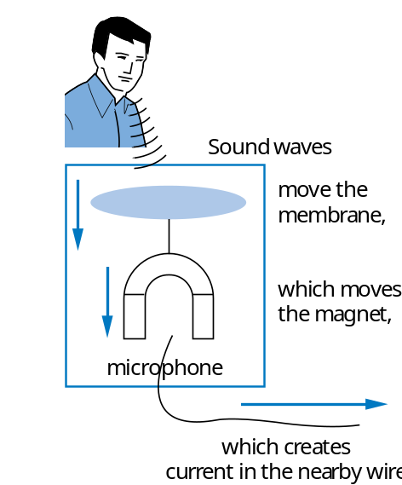
Analog vs. Digital
Analog signal
Digital signal
Infinite possible values
  E.g., speaking into a mike
Finite possible values
  E.g., pressing a button
1
2
3
4
2
digital
signal
analog
signal
Possible values:
1.00, 1.01, 2.0000009,
... infinite possibilities
4
Possible values:
0, 1, 2, 3, or 4.
That’s it.
value
value
3
2
1
0
time
time

Slide 8
Why Digitization?
Most natural events are analog
  Example?
Why digitization?
  Preserve quality
  Easier to store
  Easier to compress

Slide 9
Why Digitization: Preserving Quality
3
3
Volts
2
2
lengthy transmission
(e.g, cell phone)
1
original signal
1
received signal
0
0
time
time
How to fix—higher, lower, ?
01
10
11
10
11
a2d
Volts
1
Higher sampling
rate and more bits per
encoding improves re-creation
digitized signal
lengthy transmission
(e.g, cell phone)
1
0
0
time
time
Can fix—distinguish 0s/1s, restore
3
Volts
same
d2a
2
1
0
01
10
11
10
11
Not a perfect re-creation
due to a2d and d2a

Slide 10
Why Digitization: Preserving Quality
Analog signal quality may degrade over time
Voltage levels not saved/copied/transmitted perfectly
Digitized version enables near-perfect save/copy/transmission
“Sample” voltage at particular rate, save sample using bit encoding
Voltage levels still not kept perfectly
But we can distinguish 0s from 1s

Slide 11
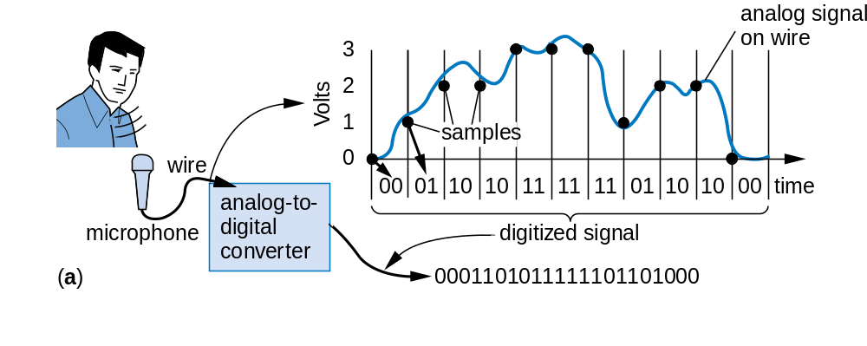
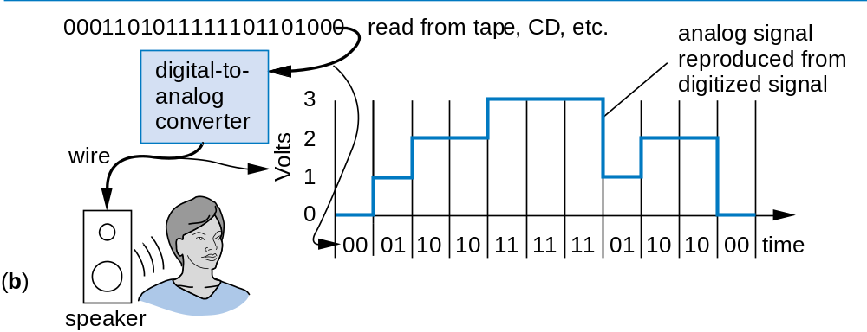
Why Digitization: Easy Storage
Store on CD, USB drive, etc. No deterioration.

Slide 12
Why Digitization: Compression
Example compression scheme:
00 means 0000000000
01 means 1111111111
    1X means X
More data can be stored in this way
  Example: 20 uncompressed songs vs. 200 compressed songs in a CD
Digital images are usually compressed
  Example: JPEG
0000000000 0000000000 0000001111 1111111111
00
00
10000001111
01

Slide 13
Digital System: Big Picture
analog
phenomena
sensors and
other inputs
electric
digital
signal
data
A2D
digital
data
Digital System
digital
digital
data
data
D2A
electric
signal
actuators and
other outputs

Slide 14
How To Represent Numbers?
Base ten (decimal)
  Ten symbols: 0, 1, 2, ..., 8, and 9
  More than 9 → next position
  So each position power of 10
Base two (binary)
  Two symbols: 0 and 1
  More than 1 → next position
  So each position power of 2
Each position represents a quantity; symbol in position means how many of that quantity

Slide 15

Binary to Decimal Conversion
Think about how decimal numbers (base 10) work
1
3
4
10
4
10
3
10
2
10
1
10
0
2
9
2
8
2
7
2
6
2
5
2
4
2
3
2
2
2
1
2
0
512
256
128
64
32
16
8
4
2
1
This method can be used to convert any base number to decimal
1
1
1
2
4
2
3
2
2
2
1
2
0
+
+
=
4 + 2 + 1
=
7

Slide 16
Decimal to Binary Conversion
Addition method – left to right
Desired decimal
Current
Binary
number:
11
sum
number
16 > 11, too big;
0
0
16
Put 0 in 16’s place
8
4
2
1
8 ≤ 11, so put
0
1
1 in 8’s place,
8
8
current sum is 8
16
4
2
1
8 + 4 = 12 > 11, so put
0
1
0
0 in 4’s place,
8
4
current sum is 8
16
8
2
1
8 + 2 = 10 > 11, so put
0
1
0
1
1 in 2’s place,
10
16
8
4
2
1
current sum is 10
10 + 1 = 11 ≤ 11, so put
0
1
0
1
1
1 in 2’s place,
11
16
8
4
2
1
current sum is 11

Slide 17
Working with Binary Numbers
Easy to tell if a number is even or odd
N bits can represent 2^{N} numbers (0 to 2^{N}-1)
Decimal | Binary | Decimal | Binary
0 | 0000 | 8 | 1000
1 | 0001 | 9 | 1001
2 | 0010 | 10 | 1010
3 | 0011 | 11 | 1011
4 | 0100 | 12 | 1100
5 | 0101 | 13 | 1101
6 | 0110 | 14 | 1110
7 | 0111 | 15 | 1111

Slide 18
Hexadecimal
Aka hex
Base 16
Often used by engineers
  Why?
Each position represents
four base-two positions
  Compact way to write binary
  numbers
2
0
F
16
4
16
3
16
2
16
1
16
0
2
0
F
0010
0000
1111
h
e
x
bina
r
y
h
e
x
bina
r
y
0
0000
8
1000
1
0001
9
1001
2
0010
A
1010
3
0011
B
1011
4
0100
C
1100
5
0101
D
1101
6
0110
E
1110
7
0111
F
1111

Slide 19
Hex to Decimal
Step 1: Convert to binary
Step 2: Convert to decimal
h
e
x
bina
r
y
h
e
x
bina
r
y
0
0000
8
1000
1
0001
9
1001
2
0010
A
1010
3
0011
B
1011
4
0100
C
1100
5
0101
D
1101
6
0110
E
1110
7
0111
F
1111

Slide 20
Decimal to Hex
Easy method: convert to binary first, then binary to hex
Convert 78 base 10 to hex
First convert to binary:
0
1
0
0
1
1
1
0
128
64
32
16
8
4
2
1
Then binary to hex:
4
E
(Quick check: 4×16 + 14×1 = 64+14 = 78)

Slide 21
Decimal to Base n
Divide-by-n method
Refer to textbook

Slide 22
From Base x to Base y
Steps
  Convert from base x to base 10
  Convert from base 10 to base y

Slide 23
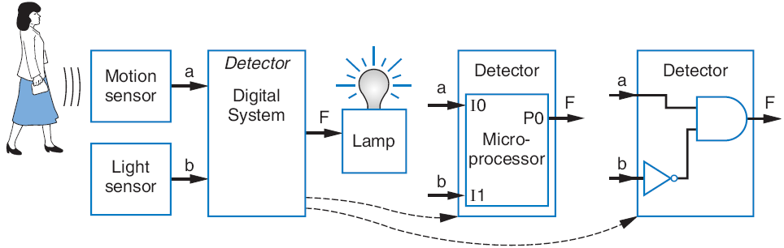
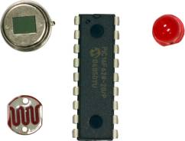
μProc or Custom Digital Circuits?
Desired motion-at-night detector
Programmed
microprocessor
Custom designed
digital circuit
I
0
P0
void main()
{
while (1) {
P0 = I0 && !I1;
// F = a and !b,
}
}
I
1
P1
I
2
P2
I
3
P3
I
4
P4
I
5
P5
I
6
P6
I
7
P7

Slide 24
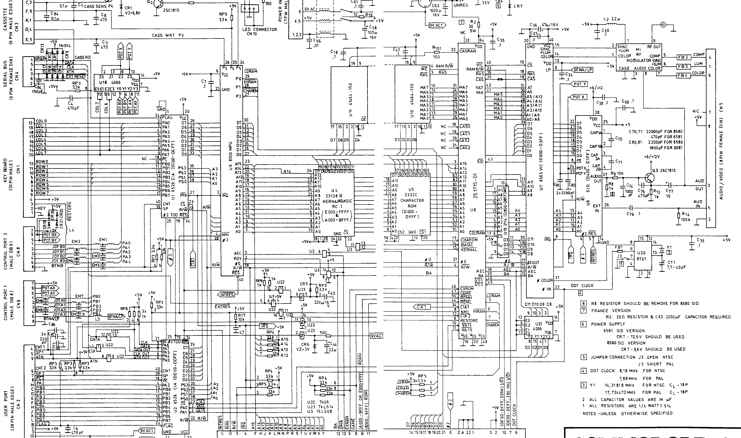
μProc Schematic

Slide 25

When μProc isn’t Enough
Wing controller computation task:
50 ms on microprocessor
5 ms on custom digital circuit
If the task must execute 100 times per second:
100 × 50 ms = 5000 ms = 5 seconds
100 × 5 ms = 500 ms = 0.5 seconds
Microprocessor too slow, circuit OK.

Slide 26
Today’s Objectives
To understand the difference between analog and digital systems
To know how to convert a number in base x to the corresponding number is base y
To understand/be able to quantify situations where custom circuits are preferred over microprocessors

Slide 27
Question
What’s (8A0)₁₆ in binary?
  You have two minutes for each quiz

